Slide 1
Finding difference in images
Thuy Nguyen, Abdulaziz Ismail, Ronalds Upenieks

Slide 2
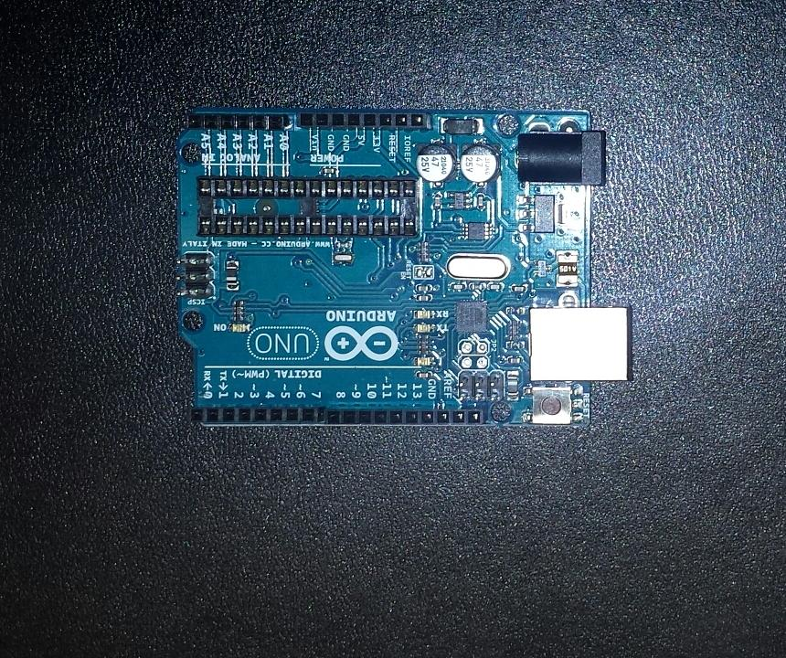
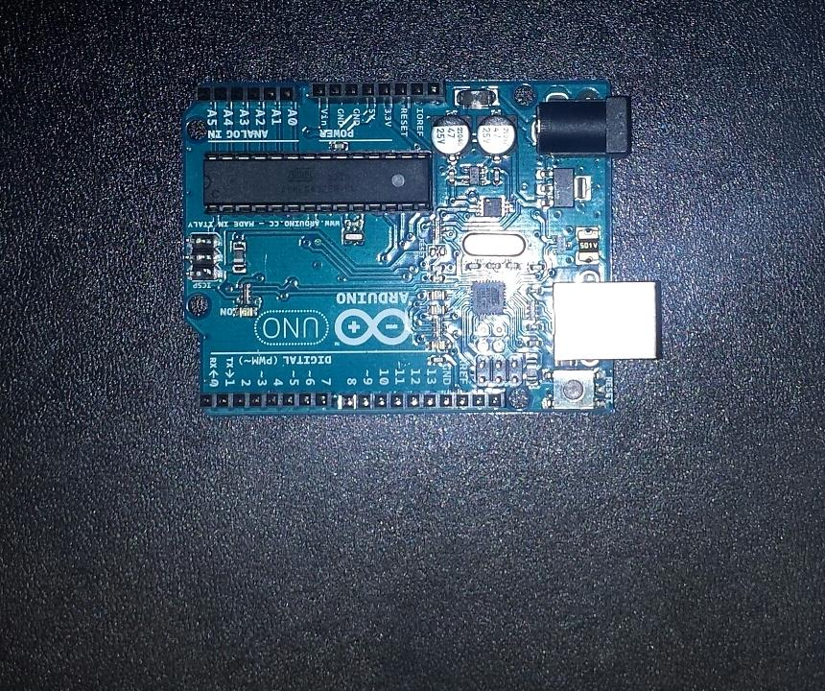
Objective: detect difference between 2 given images

Slide 3
Challenges faced
Flash
Different angle / perspective
Background: mix of differently coloured pixels
Lighting

Slide 4
Naive approach
Direct pixel comparison
Impossible given challenges mentioned
Possible on more simple images
Notes:
Flash, different angles, different perspective makes direct pixel comparison impossible.

Slide 5


Naive approach
Notes:
Direct pixel comparison possible given the fact that images have the same orientation, perspective and size. This is not the case with our project source images.

Slide 6
Research involved
SSIM – Structural Similarity Index (Difference detection)
OpenCV Grab Cut (ROI Extraction)
Self made algorithms (ROI Extraction, difference detection)

Slide 7
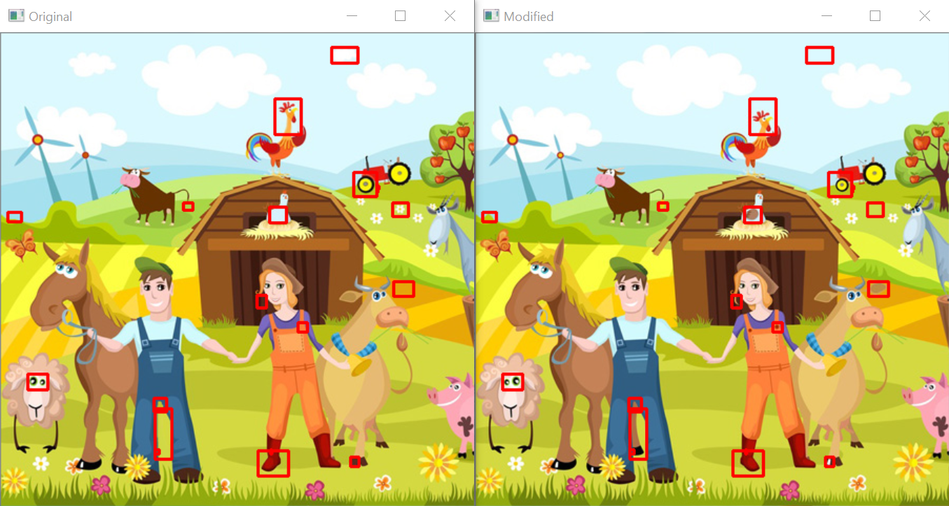
SSIM

Slide 8
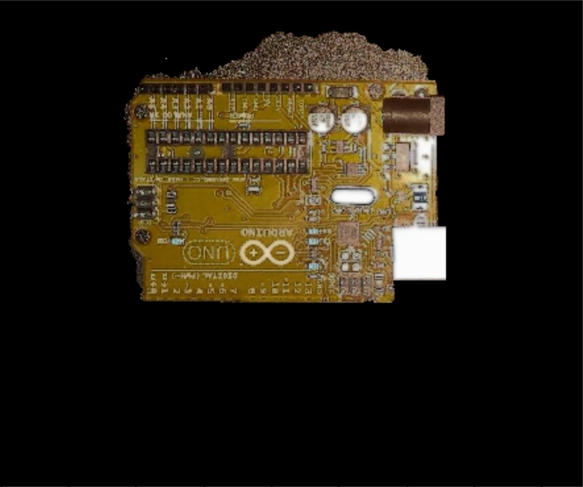
Opencv Grab cut

Slide 9
ROI extraction
ROI extracted by detecting pixel value difference in comparison to the background.

Slide 10
Flash removal
Detecting white pixels in comparison to neighbouring pixels
These pixels are then blended in with their neighbours

Slide 11
Solution: Difference Spotting
Image mapped in regions, calculating HSV colours
Shadow and lighting dealt with by setting threshold on saturation and value
Mapped regions compared from both images, coordinates extracted from differing
Regions with differences exceeding threshold marked

Slide 12
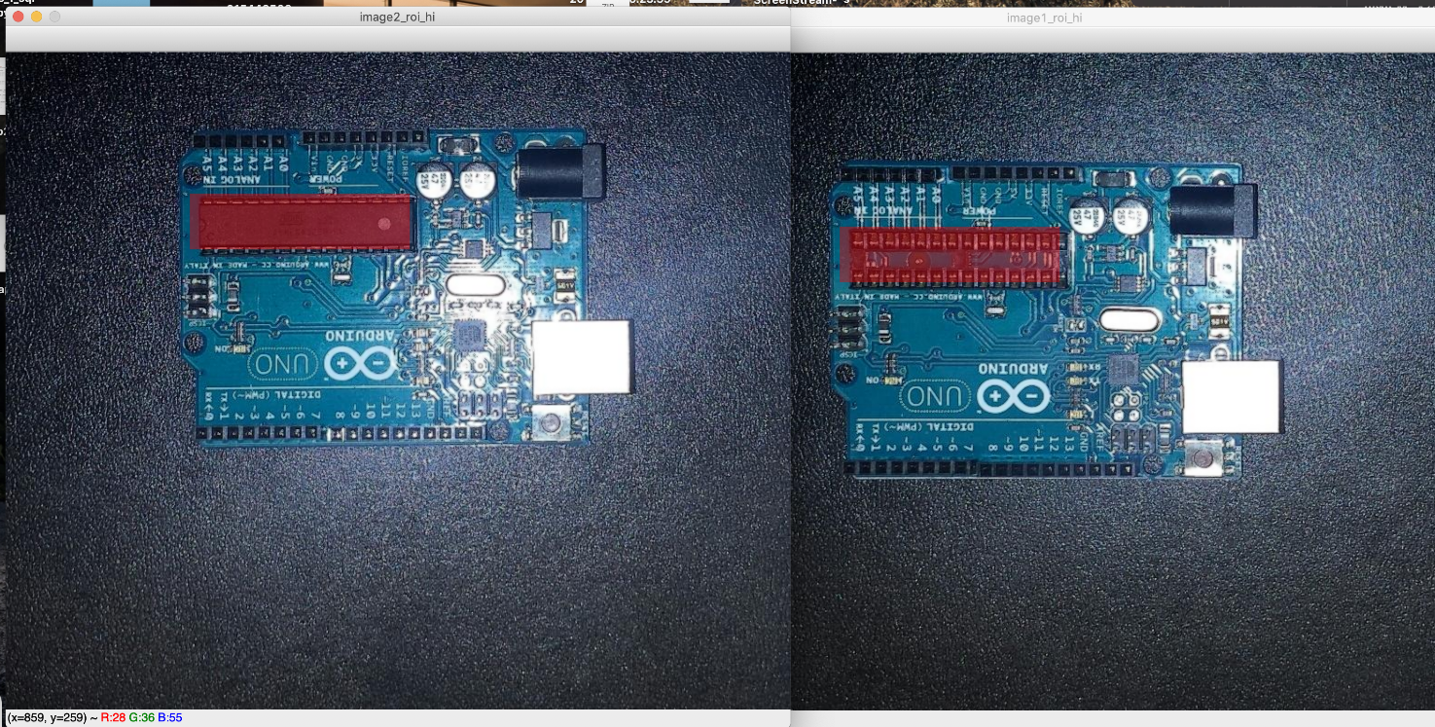
Results

Slide 13
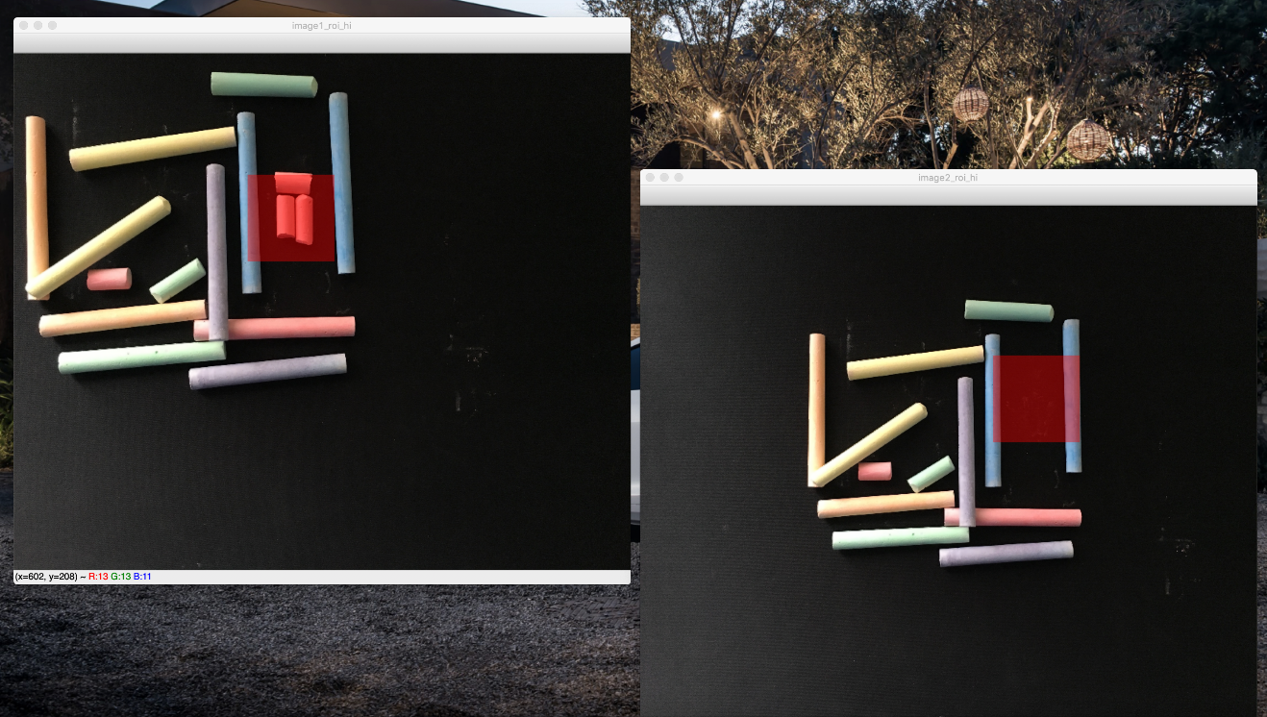
Other images

